Slide 1
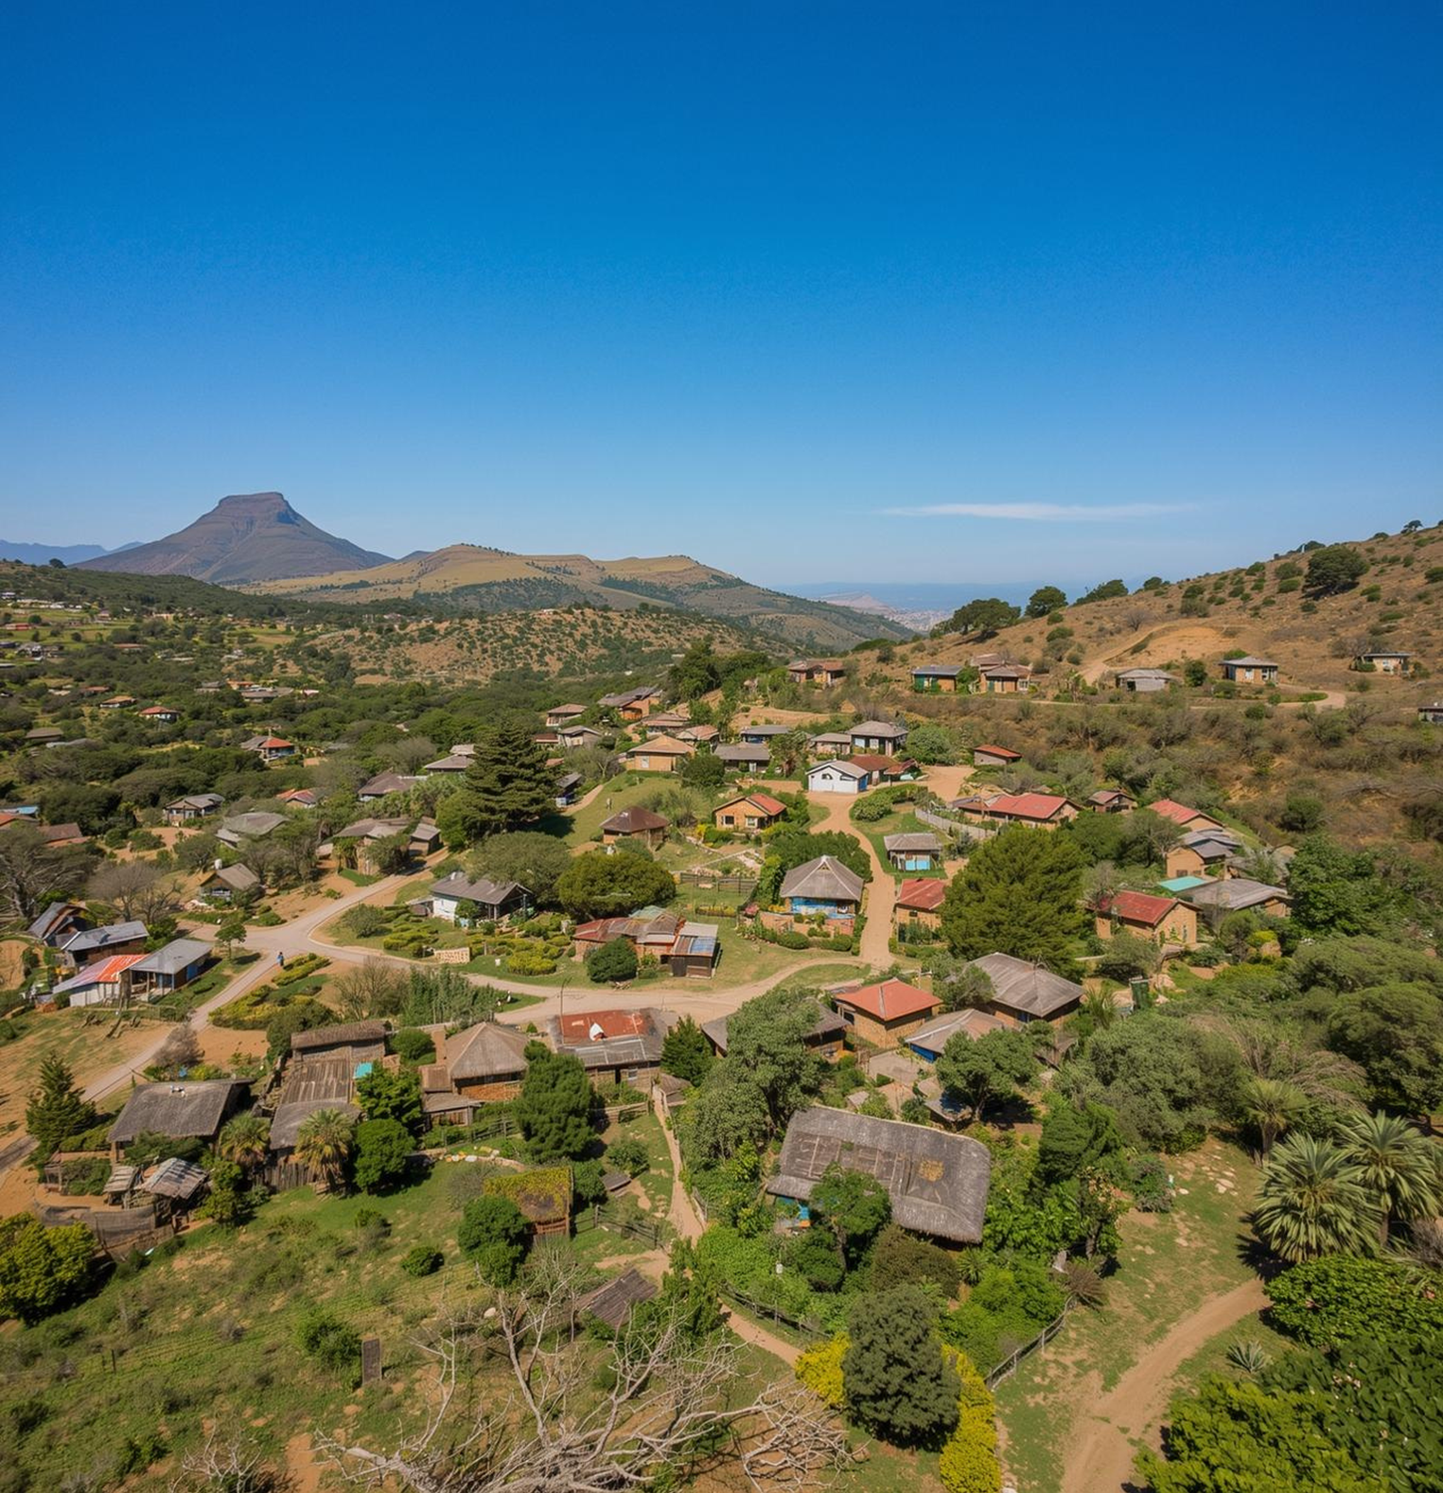
MCP
Enhancing Rural Service Accessibility by Team Synergy
Team members:
Malwande
Sinalo
Abongile
Gideon
Clint

Slide 2

Empowering Communities
The Problem
In many rural communities across South Africa, limited access to reliable internet, digital services, and affordable communication tools continues to deepen the digital divide.
Despite the growing availability of mobile devices, there is no unified, locally-adapted platform that enables offline communication, service access, and community coordination in low-connectivity environments.
Therefore, there is an urgent need for a modular, lightweight, and inclusive mobile connectivity platform (MCP) that empowers rural users to communicate, access services, and share local content — even in the absence of stable internet.

Slide 3


Solution by Bridging the Gap
In rural South Africa, advanced AI solutions can transform connectivity and service accessibility.
Innovative Solutions for Rural Connectivity
Leverage AI to enhance service accessibility, ensuring effective infrastructure development and connectivity for underserved communities.
Empower
Translating user requests into actionable solutions.

Slide 4
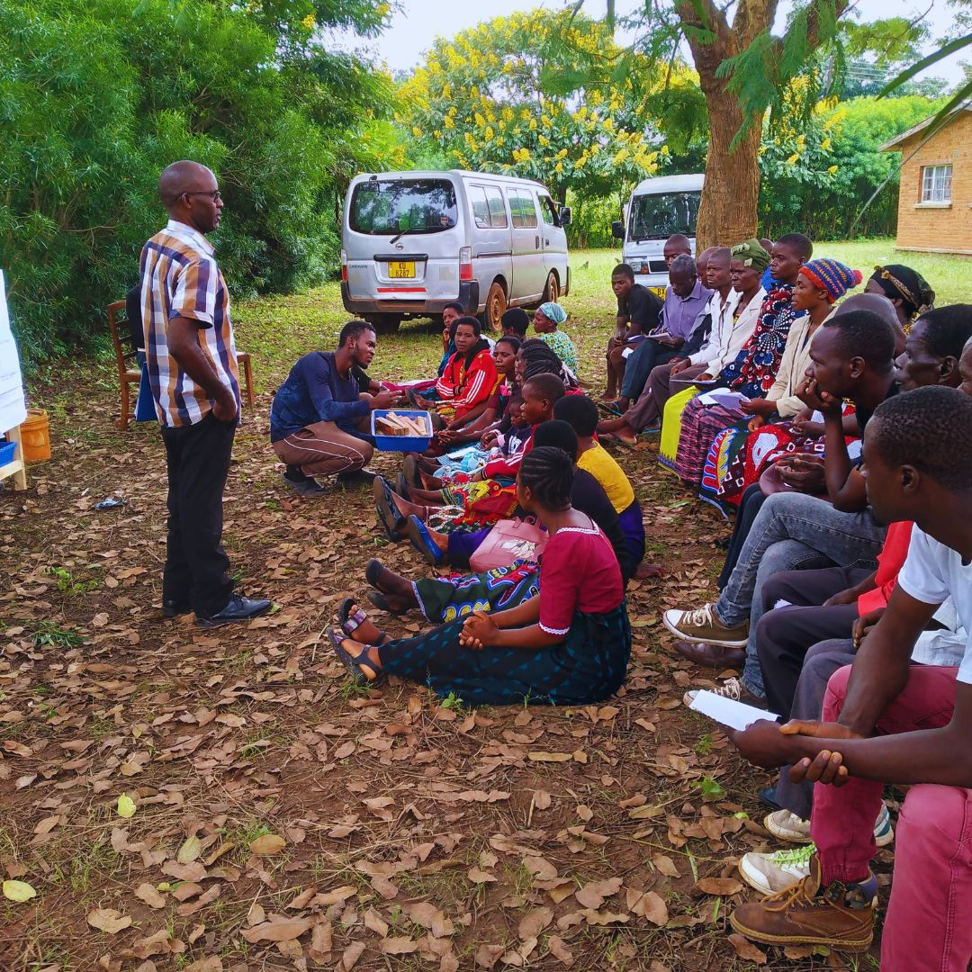

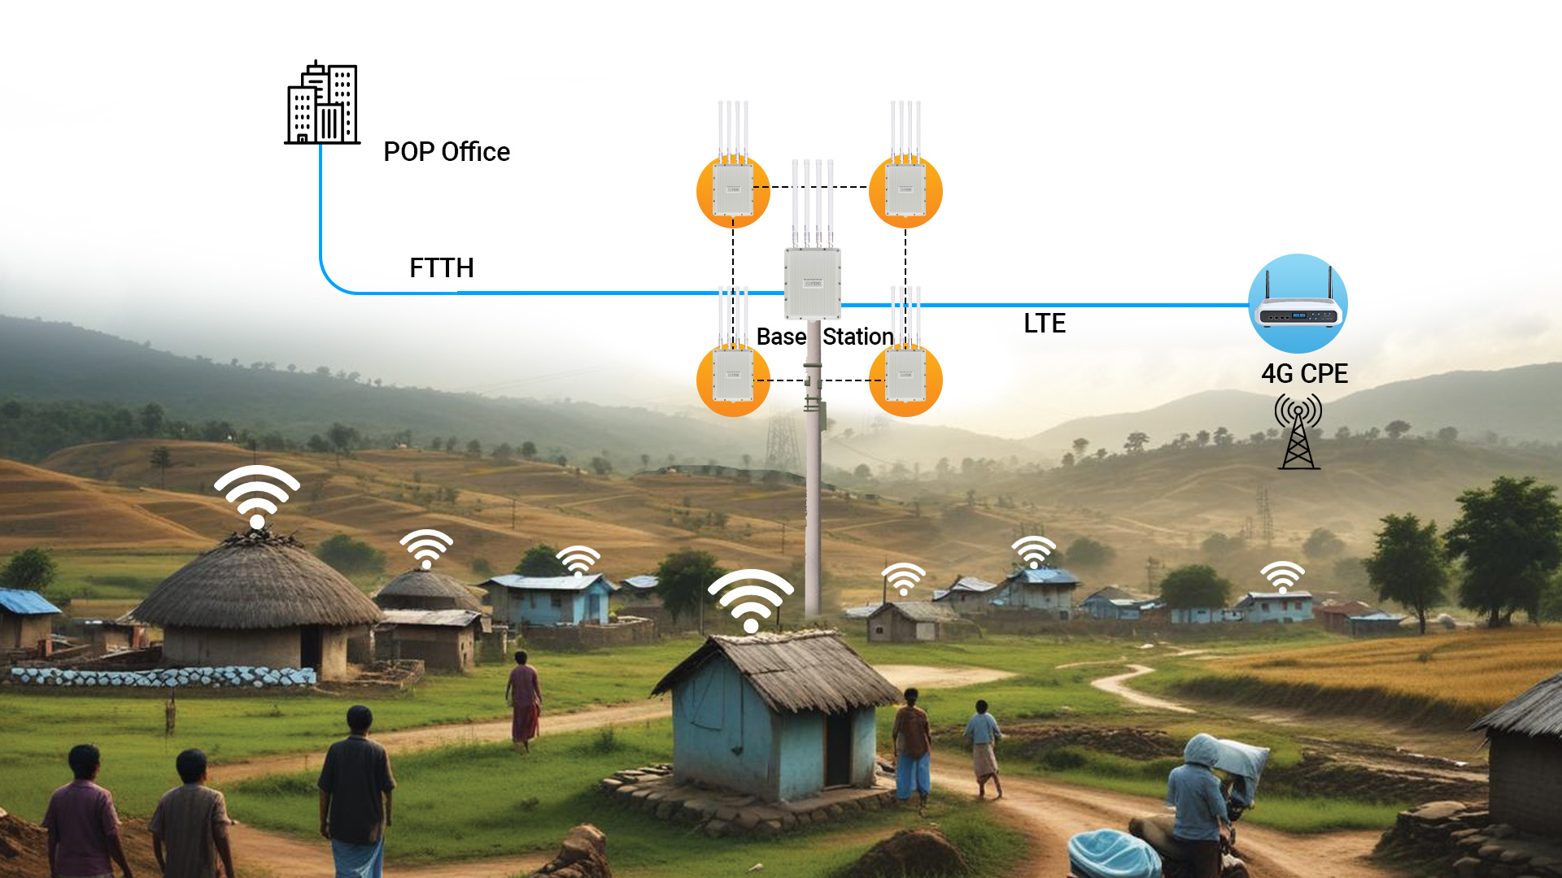
Enhancing Connectivity in Rural Areas
01
02
03
Coverage
Infrastructure
Empower
Detecting uncovered regions for improved service access.
Checking Openserve infrastructure for connectivity solutions.
Translating user requests into actionable solutions.

Slide 5
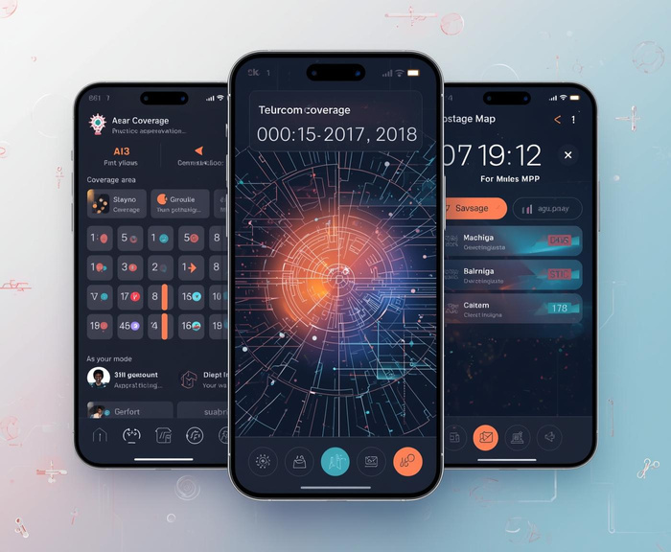


Key Features of Telecom Accessibility Solutions
03
01
02
Localization and Language Support
Low-Bandwidth Optimization
Multi-Channel Access (USSD, SMS, Voice, App)
Compressed data, offline caching, adaptive media quality, and progressive loading
isiXhosa or isiZulu voice prompts, local dialect support, culturally adapted icons and workflows.
USSD menus for banking or health info, SMS alerts, voice prompts in local languages.

Slide 6


Connectivity Solutions
Community Wi-Fi Mesh Networks
Description: Localized networks using interconnected routers to share the internet across homes, schools, and clinics.
Benefits:
Low-cost infrastructure
Can operate with one central internet source
Supports local content caching and offline access
Satellite Internet Access
Description: Satellite-based broadband (e.g., Starlink, ViaSat) offers coverage in areas with no terrestrial infrastructure.
Benefits:
Rapid deployment in remote areas
High-speed access for schools, clinics, and hubs
Can be paired with solar and hydrogen power systems

Slide 7

Advanced AI Solutions
AI-Driven Network Optimization
What it does: Uses machine learning to analyze traffic patterns, signal strength, and user behavior to adjust network parameters dynamically.
Benefits:
Improves coverage in underserved areas
Reduces congestion and dropped connections
Enables smart allocation of bandwidth and resources
Intelligent Content Delivery & Caching
What it does: AI predicts user needs and pre-loads relevant content (e.g., health tips, school lessons, market prices) during brief connectivity windows.
Benefits:
Reduces data usage and costs
Enables offline access to critical information
Personalizes content based on local context and language

Slide 8

MCP AI Agent
The MCP AI Agent acts as a digital facilitator for rural users, enabling access to services, content, and communication — even in low-connectivity environments. It’s not just a chatbot; it’s a context-aware assistant that adapts to local needs, languages, and infrastructure constraints.
Module | AI Agent Role | Impact
Health | Symptom checker, clinic locator, vaccine reminders | Improves rural health outcomes
Education | Homework help, exam prep, career guidance | Boosts learning and retention
Agriculture | Weather alerts, crop advice, market prices | Enhances productivity and income
Governance | Local news, service access, feedback collection | Strengthens civic engagement

Slide 9
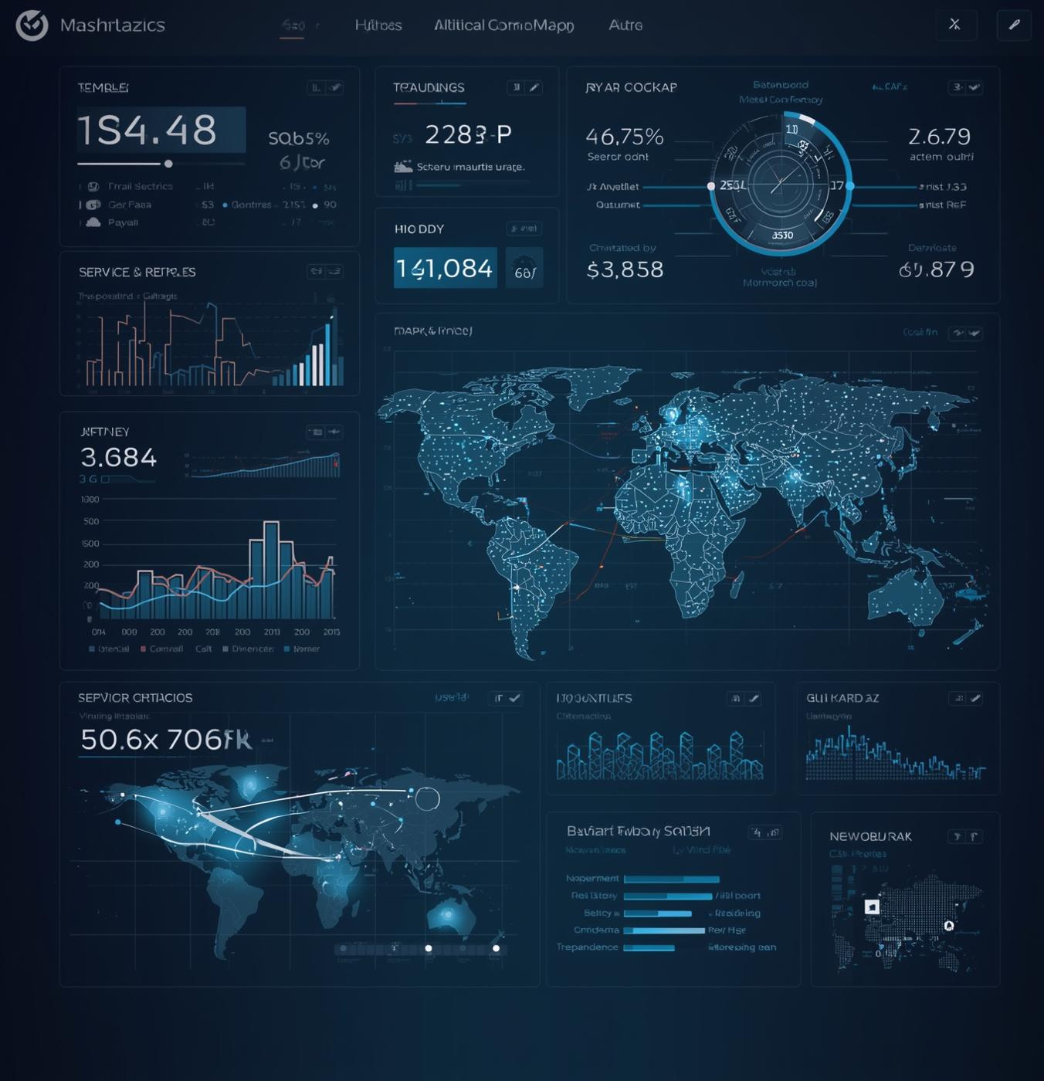
Data-Driven Decisions
Objective | Key Result | Metric
Expand digital access | 5,000+ rural users onboarded within 12 months | User registrations, active sessions
Improve service delivery | 80% of users access health, education, or civic services monthly | Service Access logs, module usage
Enhance offline resilience | 90% of content accessed without live internet | Cached content delivery rate
Boost local engagement | 100+ community posts/month on bulletin board | Community interaction metrics
Support low-literacy users | 70% of interactions via voice or local language | Input mode analytics

Slide 10
THANK YOU

